Slide 1
Do Tossed Coins Tend to Land on the Side They Started?
Iver Jiang

Slide 2
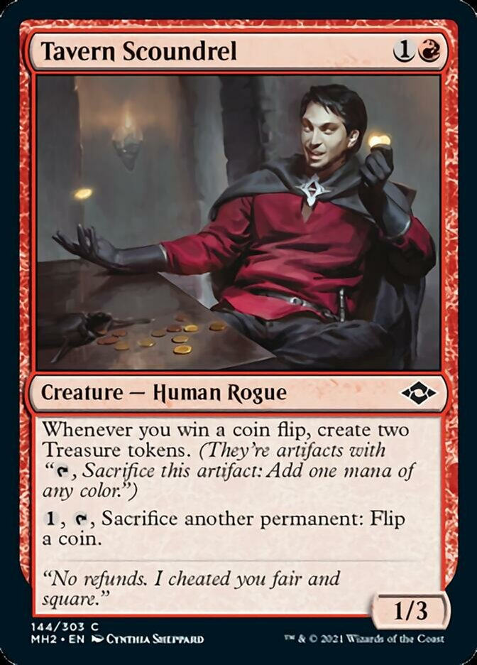
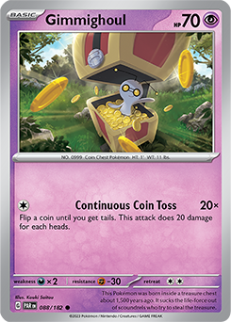

Slide 3
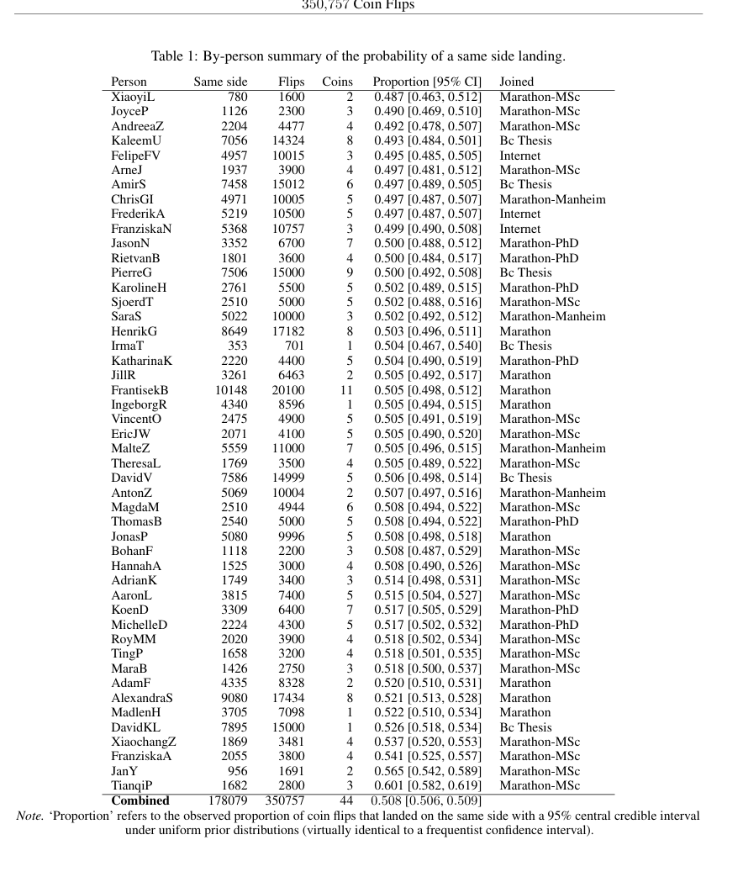
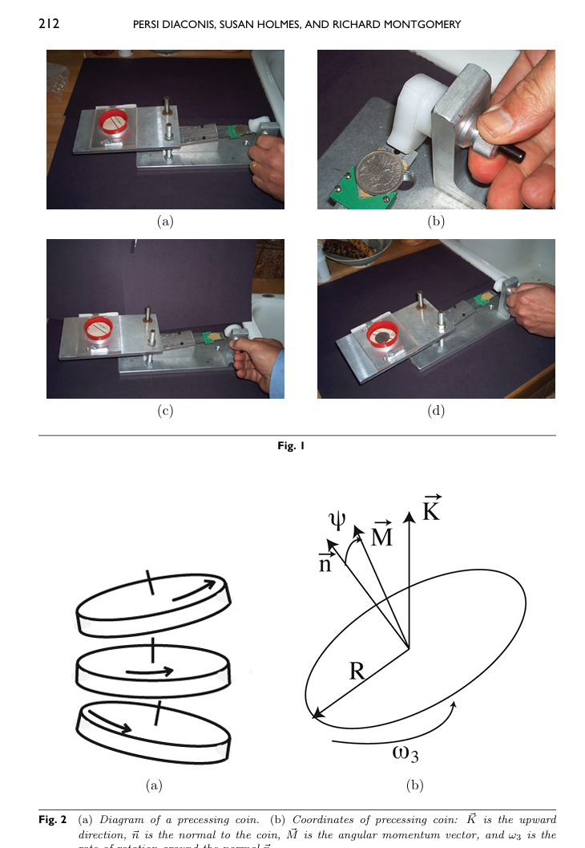

Slide 4
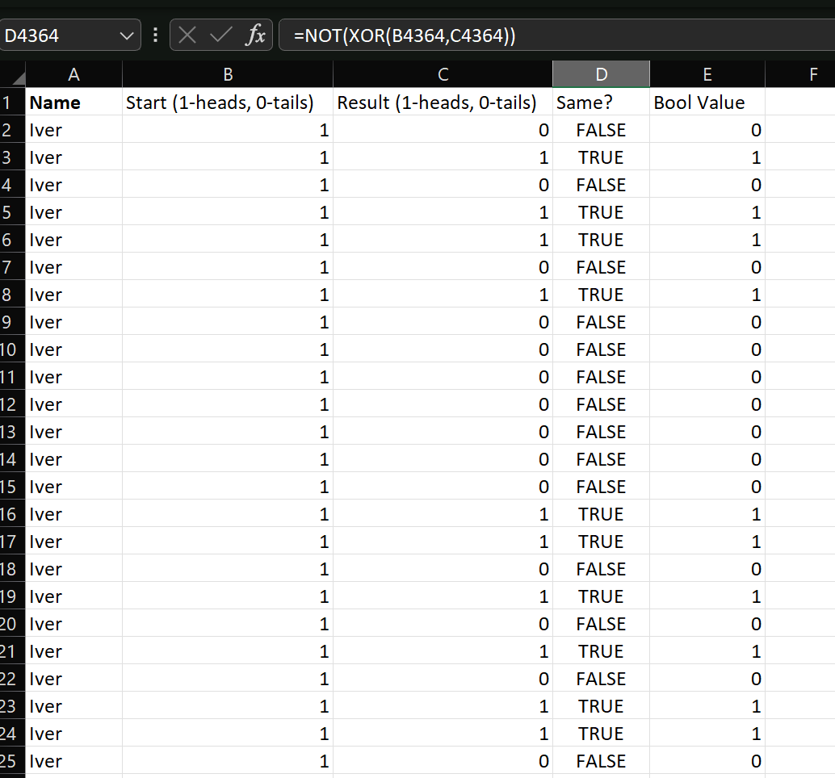

Slide 5
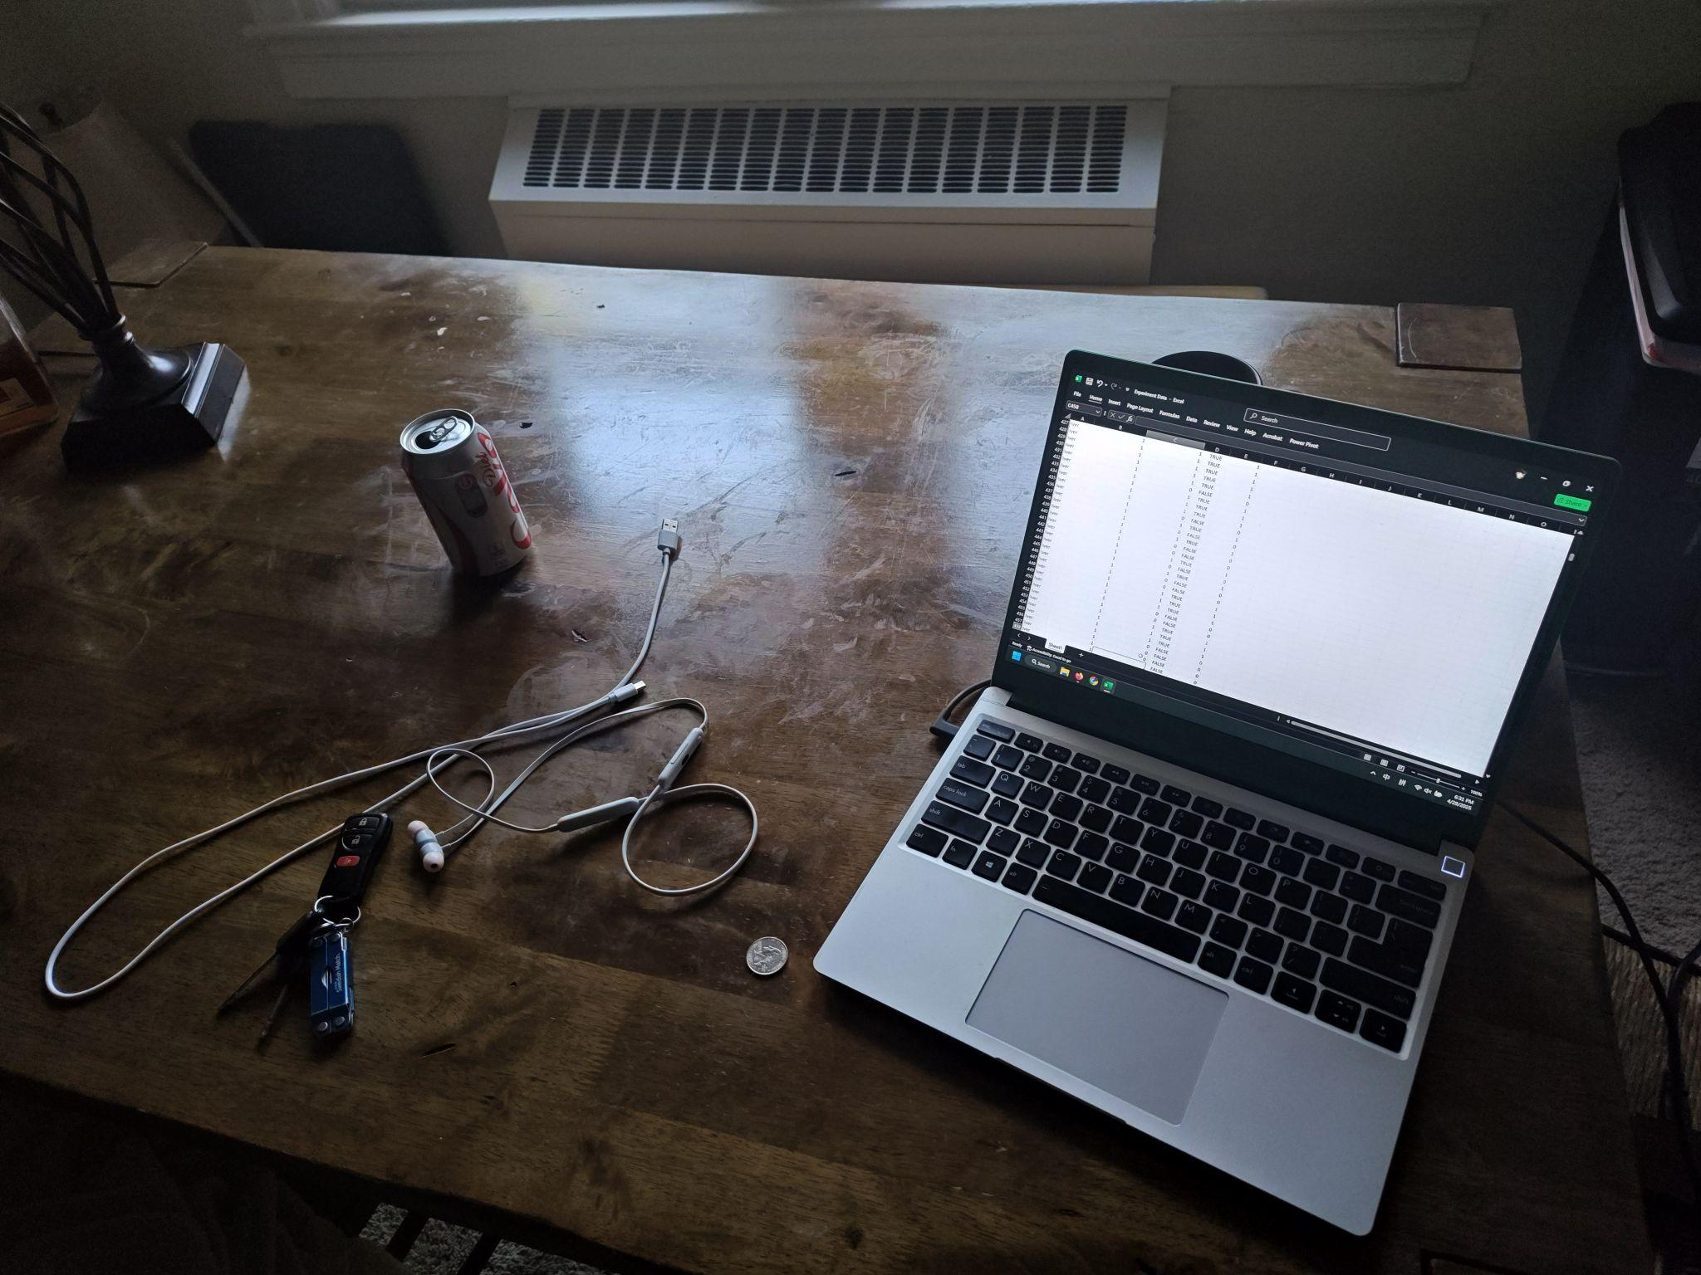

Slide 6
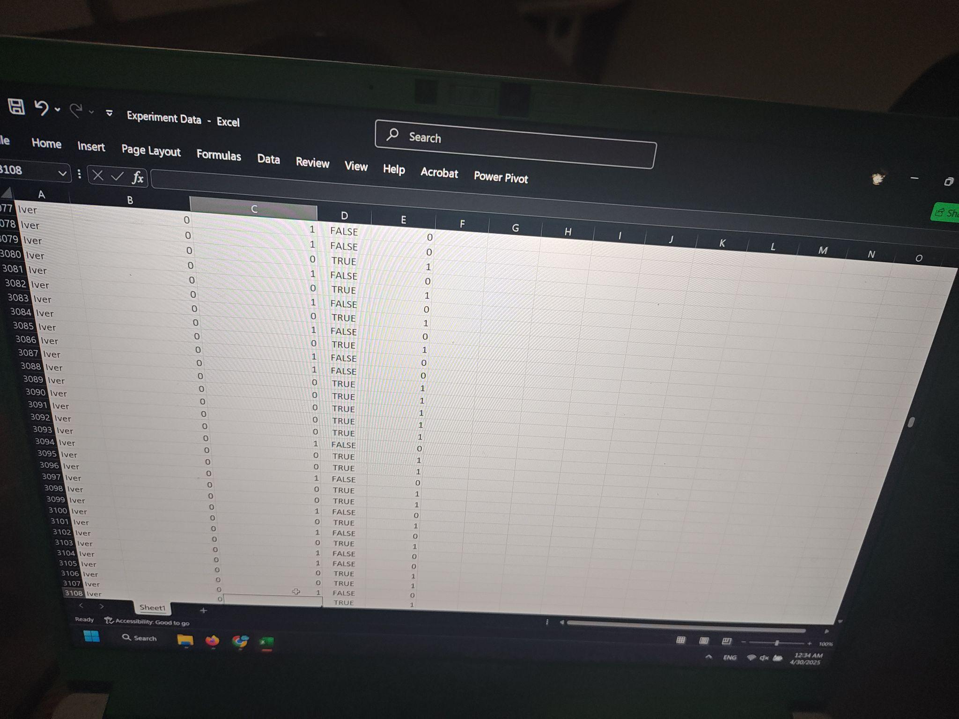

Slide 7
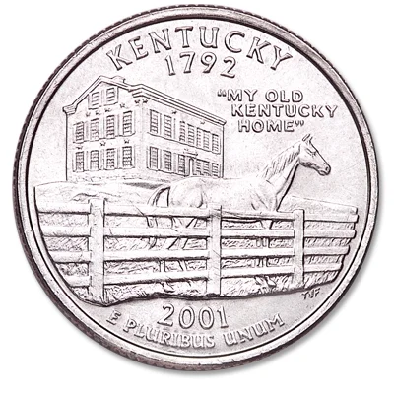
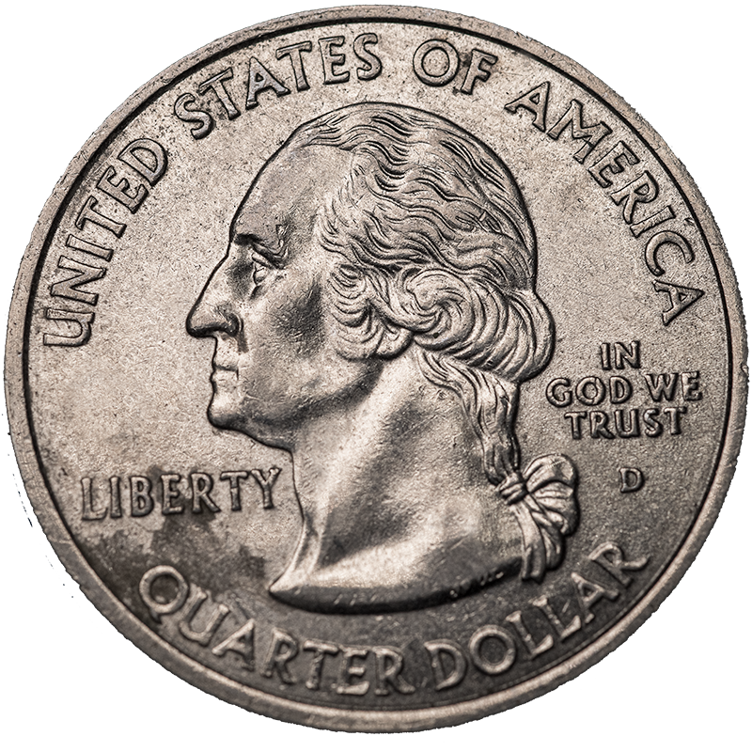

Slide 8
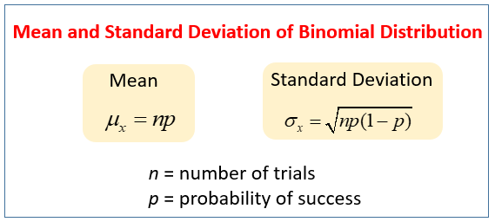

Slide 9
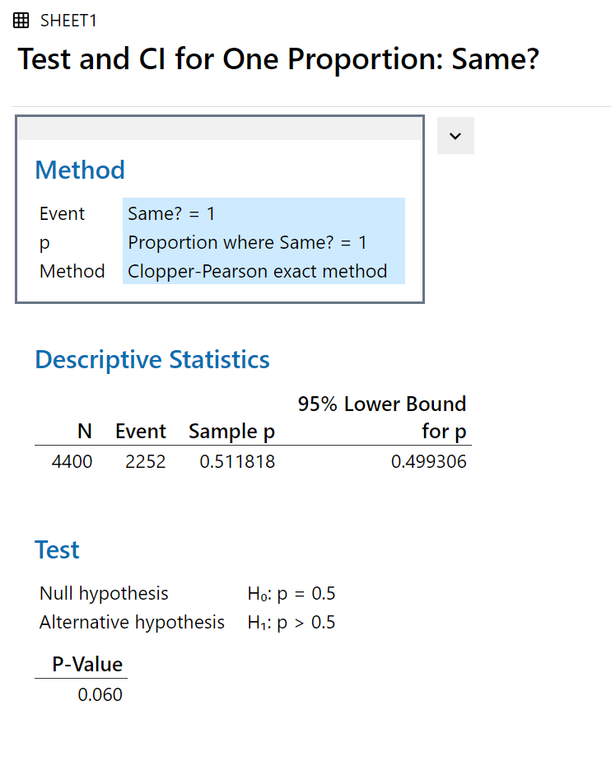
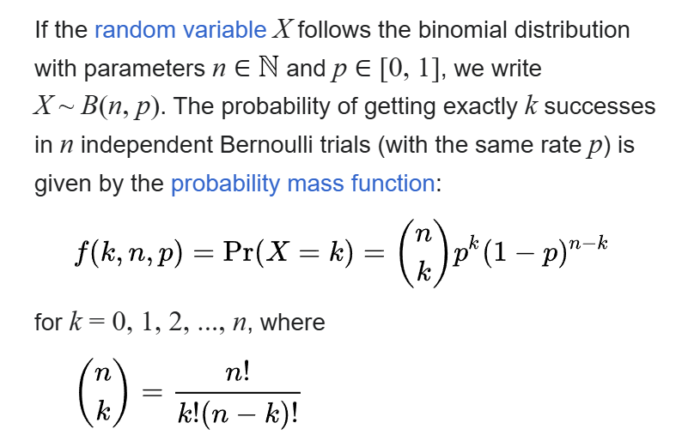
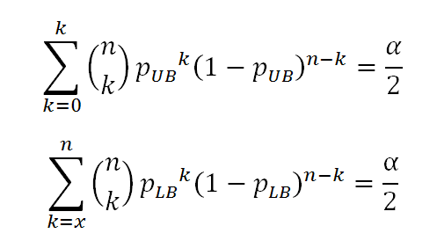
n: Number of trials
x: amount of successes
K: every single possibility of success
LB: lower bound
UB: upper bound

Slide 10
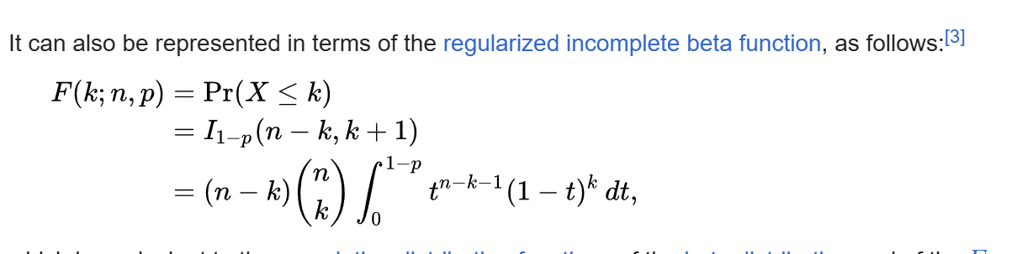
n: Number of trials
p: given probability of events (successes)
k : number of actual successes

Slide 11
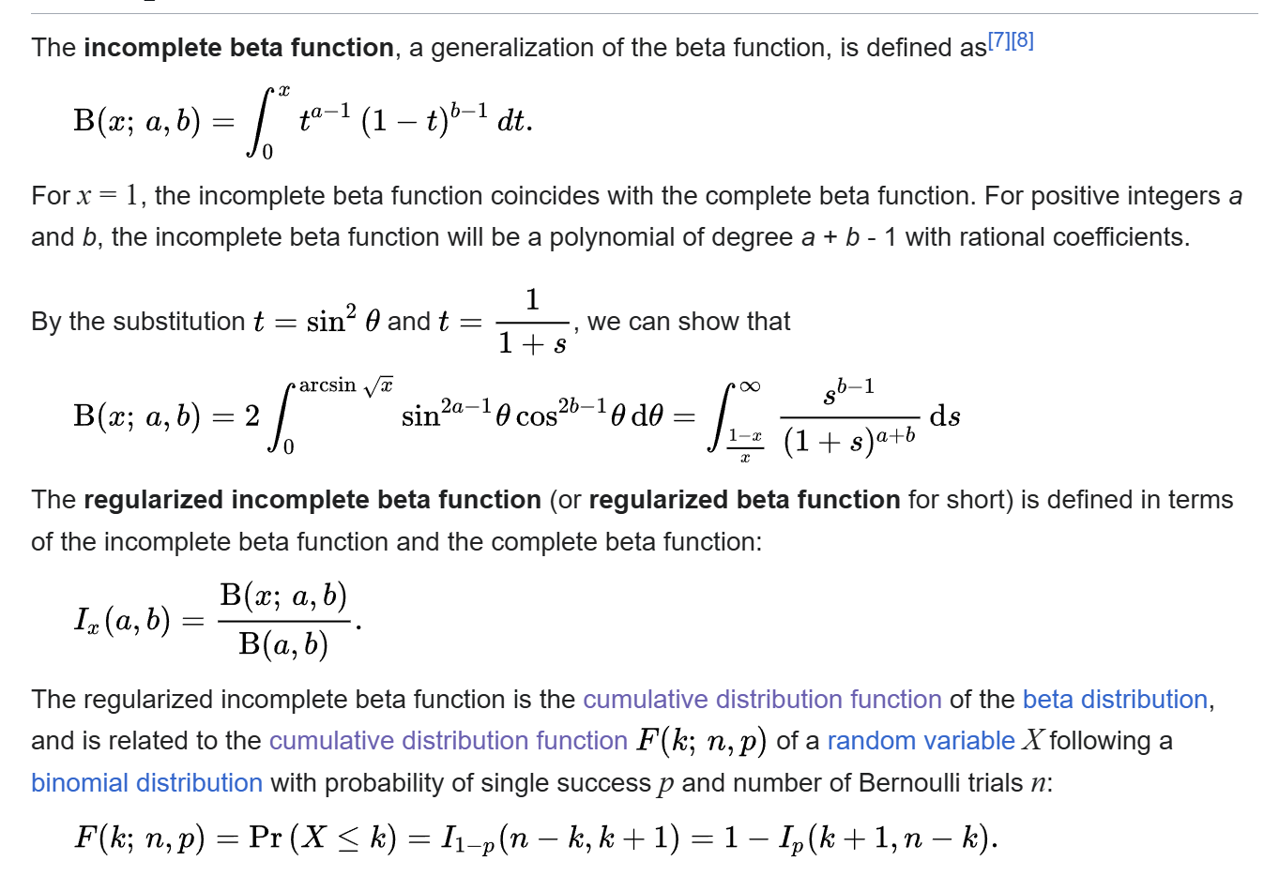

Slide 12
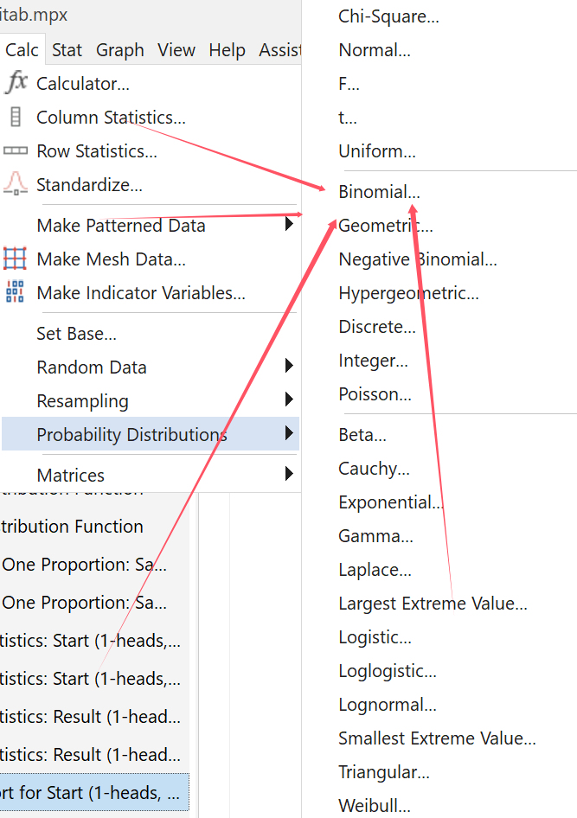

Slide 13

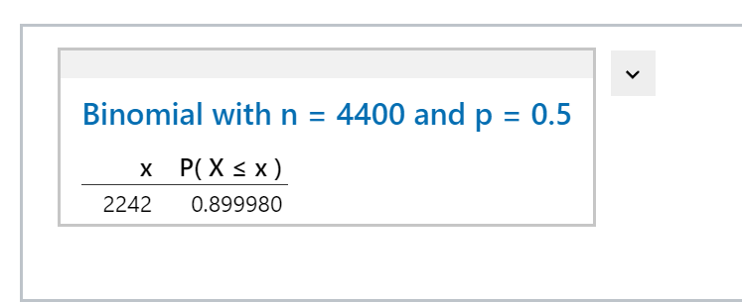

Slide 14

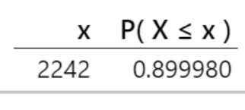
Results!
Did we prove that coins land on the same side they started on > 50% of the time? Maybe. (Depending on Alpha… P value = 0.06)
I will still bet $100 that the alternative hypothesis is true…
Could have done more tests.
Maybe Kentucky coins are just weird…
If we have alpha = 0.1 then we can (almost) say that the coin has a heads bias! Interesting…

Slide 15
Bibliography:
1. František Bartoš et al. Fair Coins Tend to Land on the Same Side They Started: Evidence from 350,757 Flips. https://arxiv.org/abs/2310.04153, 2023
2. Persi Diaconis et al. Dynamic Bias in the Coin Toss. https://www.stat.berkeley.edu/~aldous/157/Papers/diaconis_coinbias.pdf, 2007

Slide 16


